Slide 2
20 in 20: Quick Tips for SAS Enterprise Guide Users
Kelly Gray, SAS Institute

Slide 3
Kelly Gray
I am a 20 year SAS user who loves manipulating data. I have a degree in Journalism from the University of North Carolina at Chapel Hill, and a Certificate in Computer Programming from North Carolina State University. I've worked in Technical Support, Education, Sales, and Marketing and love sharing my knowledge of programming and reporting using SAS.

Slide 4
Customize Options
Program Editor
Logs & Status
Tasks & Queries

Slide 5
Customize Options!

Slide 6
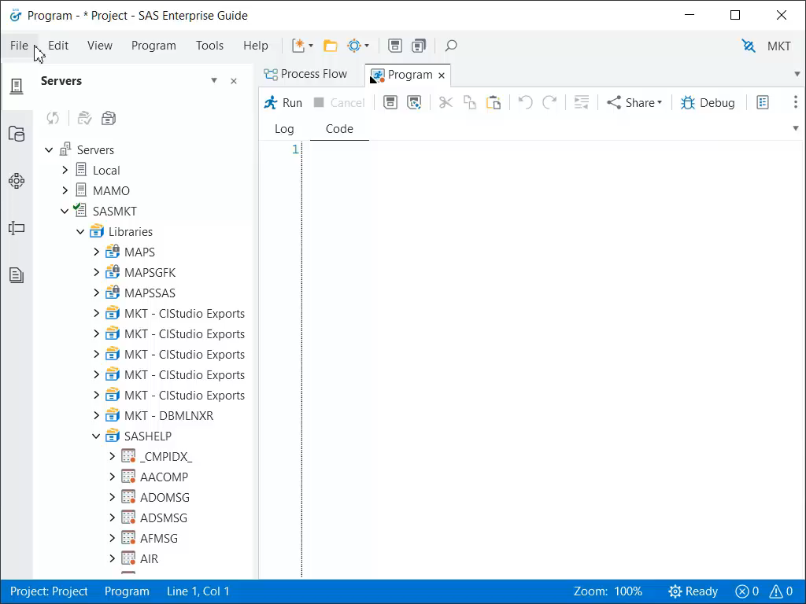
1. Pin Recent Items & Locations
Notes:
EG 8 new feature
File → open select code/project
Recent locations, see what you’ve opened, and “pin” so that it’s always easily avail

Slide 7
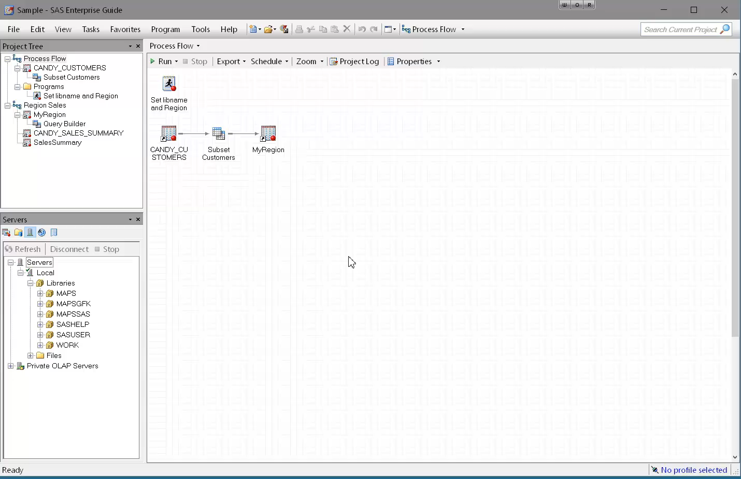
2. “Autoexec” Process Flow
Notes:
Automatically runs the process flow WHEN OPENING PROJECT
Could use to define datasets used in the project, libraries, macros, etc.
Name the process flow you want to run to “Autoexec”
Save the project
Close, reopen project
Select that you want to run autoexec when prompted
Check to make sure the library was created and assigned
Can force it to run automatically via tools → options → General → “ Automatically run autoexec process flow when project opens” ( EG 8 Tools→ options→ Project & Process Flows)

Slide 8
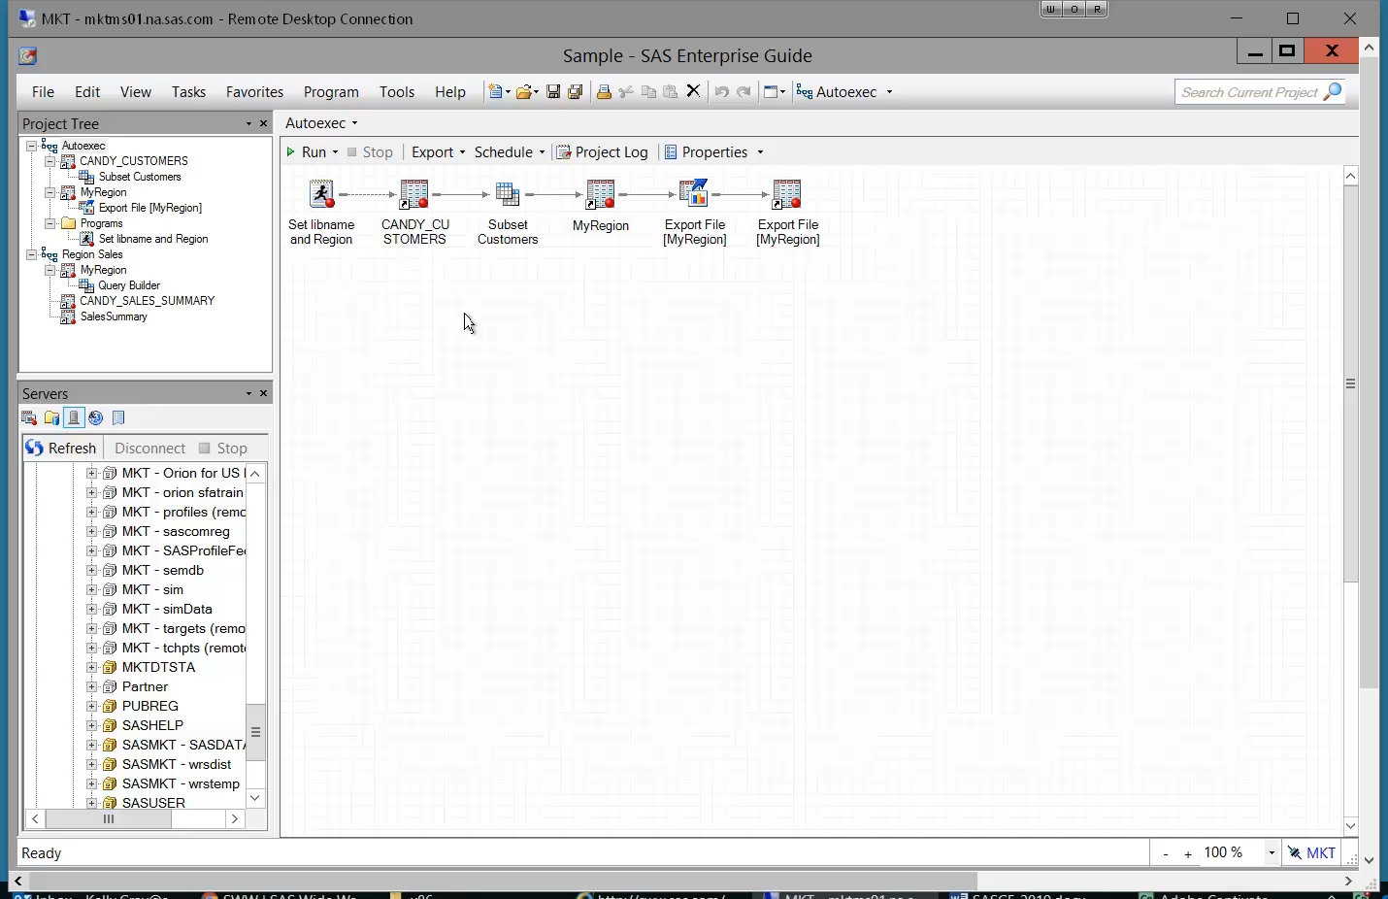
3. Split View into Multiple Windows
Notes:
FAVORITE tip
Stacked OR Split
Can use to view code and log or results at the same time
EG 8 EXTREMELY customizable – can have windows on other monitors

Slide 9
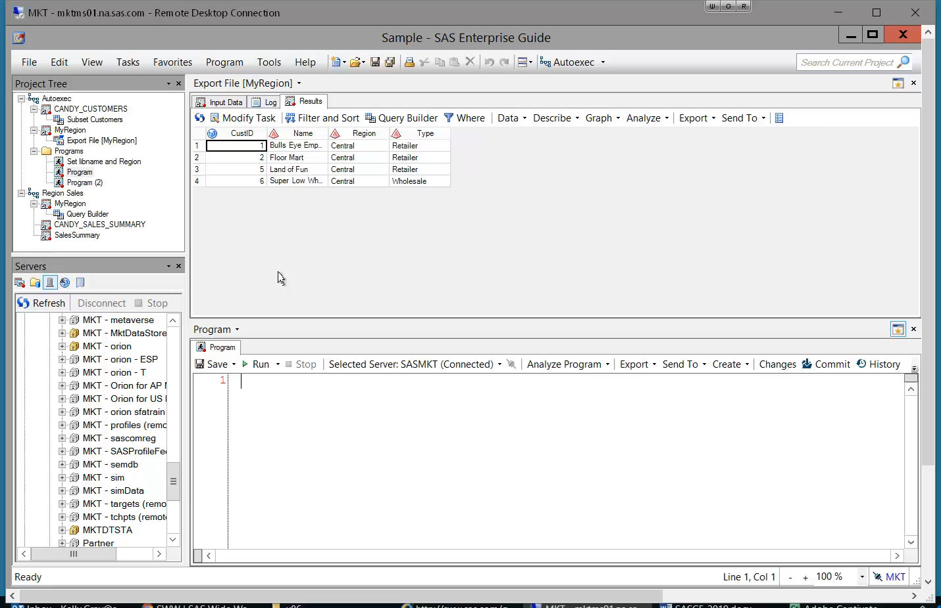
4. Reset Default Layout
Notes:
A lot of ways to customize the layout of the project……can sometimes be hard to get it “reset” if you want to change things
Use Restore Window Layout to “find” missing windows, if a mouse is behaving badly, or you just want to start over
Tools → Options → General → Restore Window Layout (EG 8 View→ Reset to Default Layout)

Slide 10
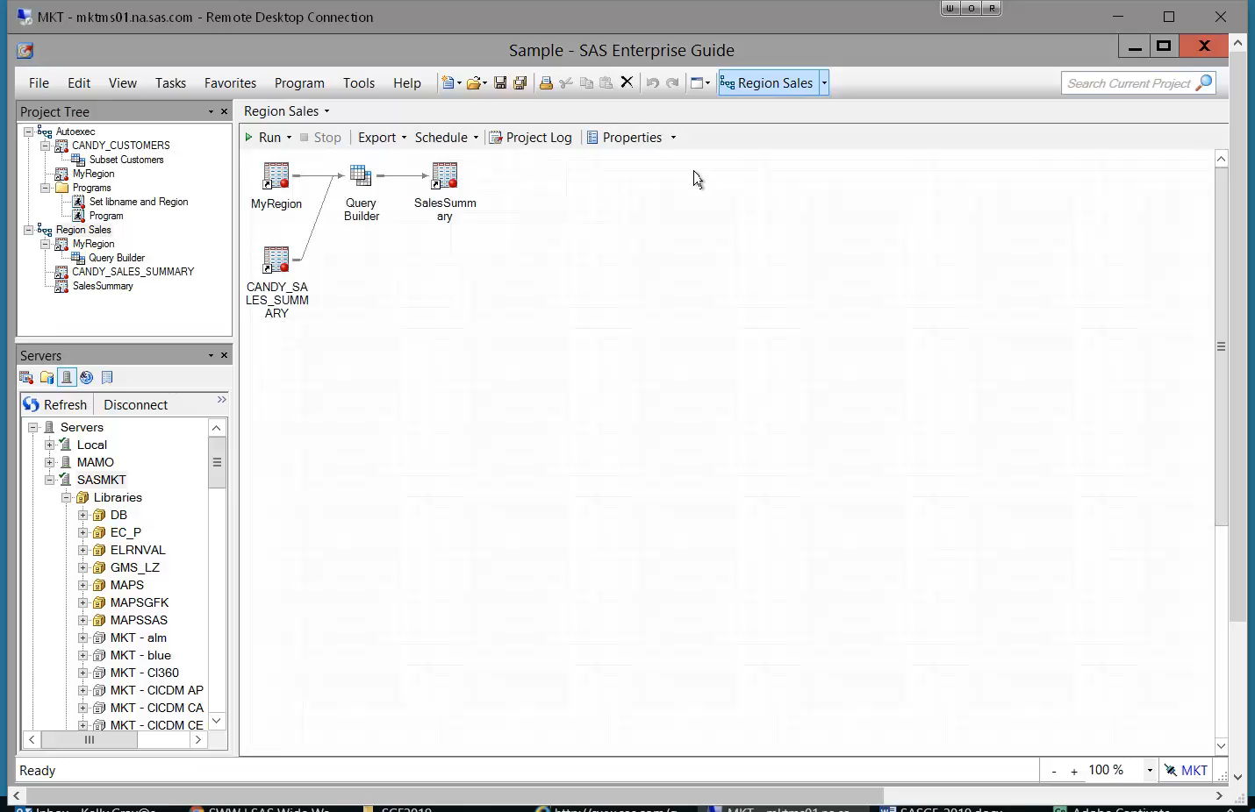
5. Automatically Replace Task Results
Notes:
Save a step from having to choose “yes” each time
Tools → Options → Results : “Prompt before replacing” is default
Do not replace
Replace without prompting
In EG 8, Replace without prompting is the default

Slide 11
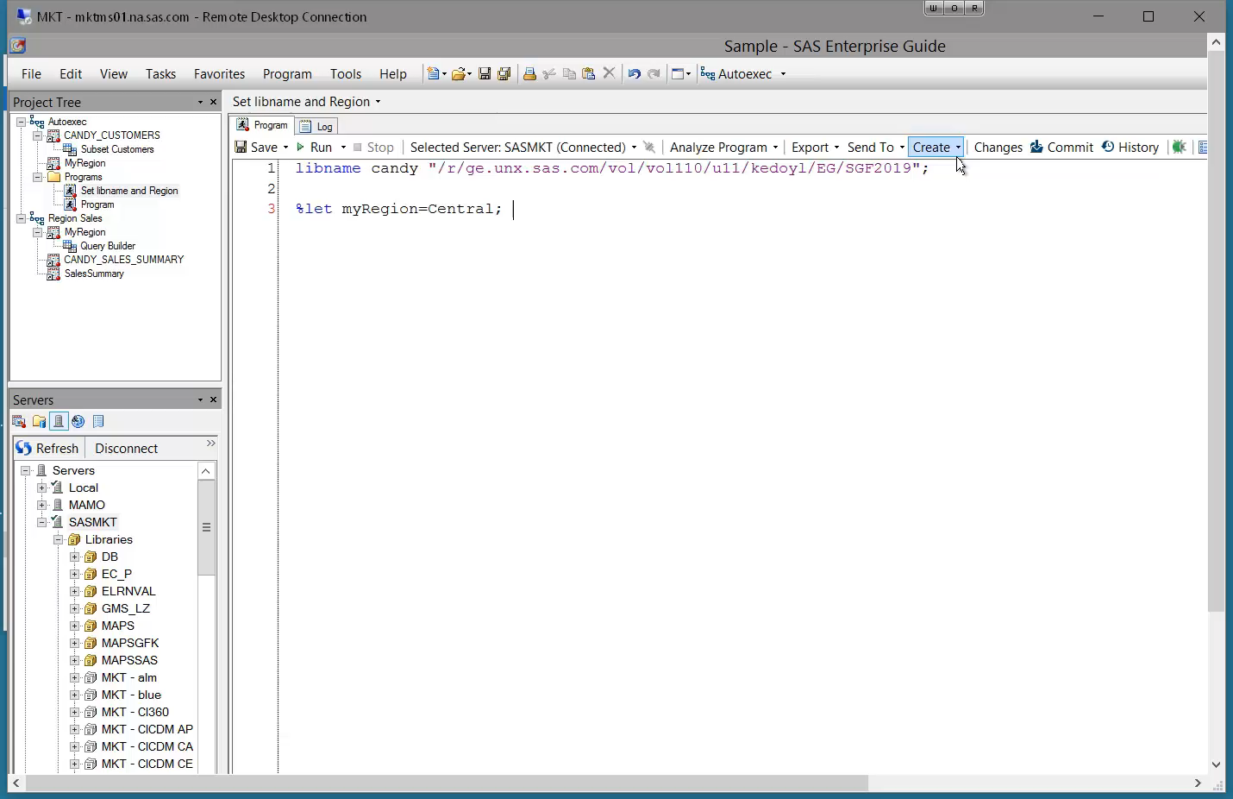
6. Automatically Submit Custom SAS Code
Notes:
Can use to have libnames assigned, macros created, etc WHEN SERVER IS CONNECTED
Tools → Options → SAS Programs : Submit SAS code when server is connected
Disconnect server
Reconnect – CANDY library is there and assigned

Slide 12
Program Editor!

Slide 13
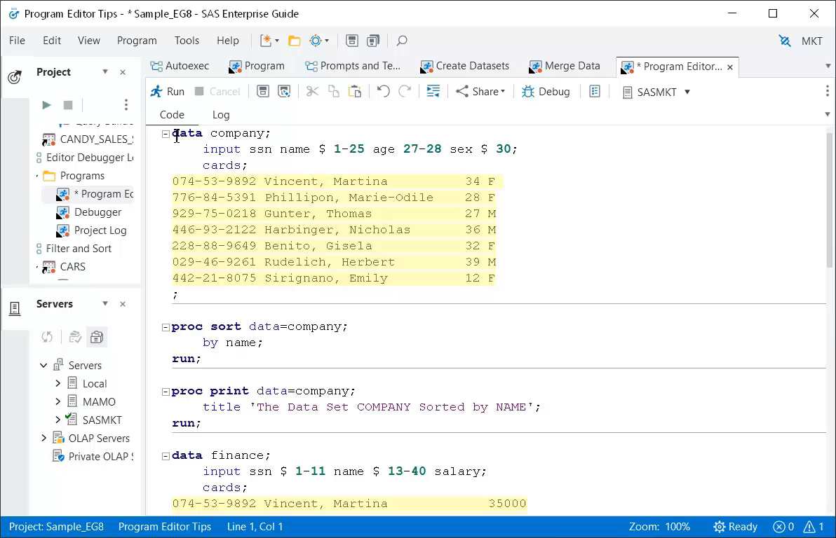
7. Turn on Line Numbers
Notes:
Helpful for debugging
Tools -> options -> SAS Programs → Editor options
In EG 8, can also right click in program editor to turn on line #’s

Slide 14
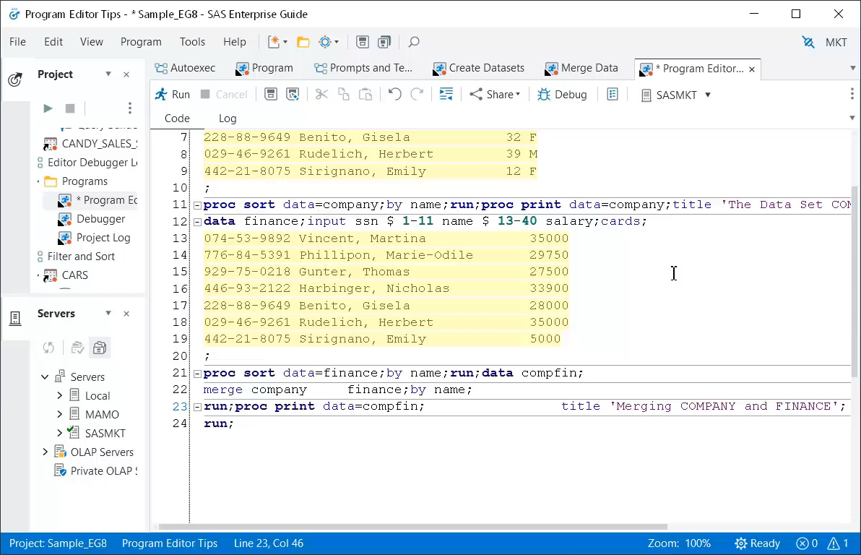
8. Automatically Format Code
Notes:
Time saver for when you’re being a lazy coder
Right click → format code
OR
EG 7 Edit → Format Code

Slide 15
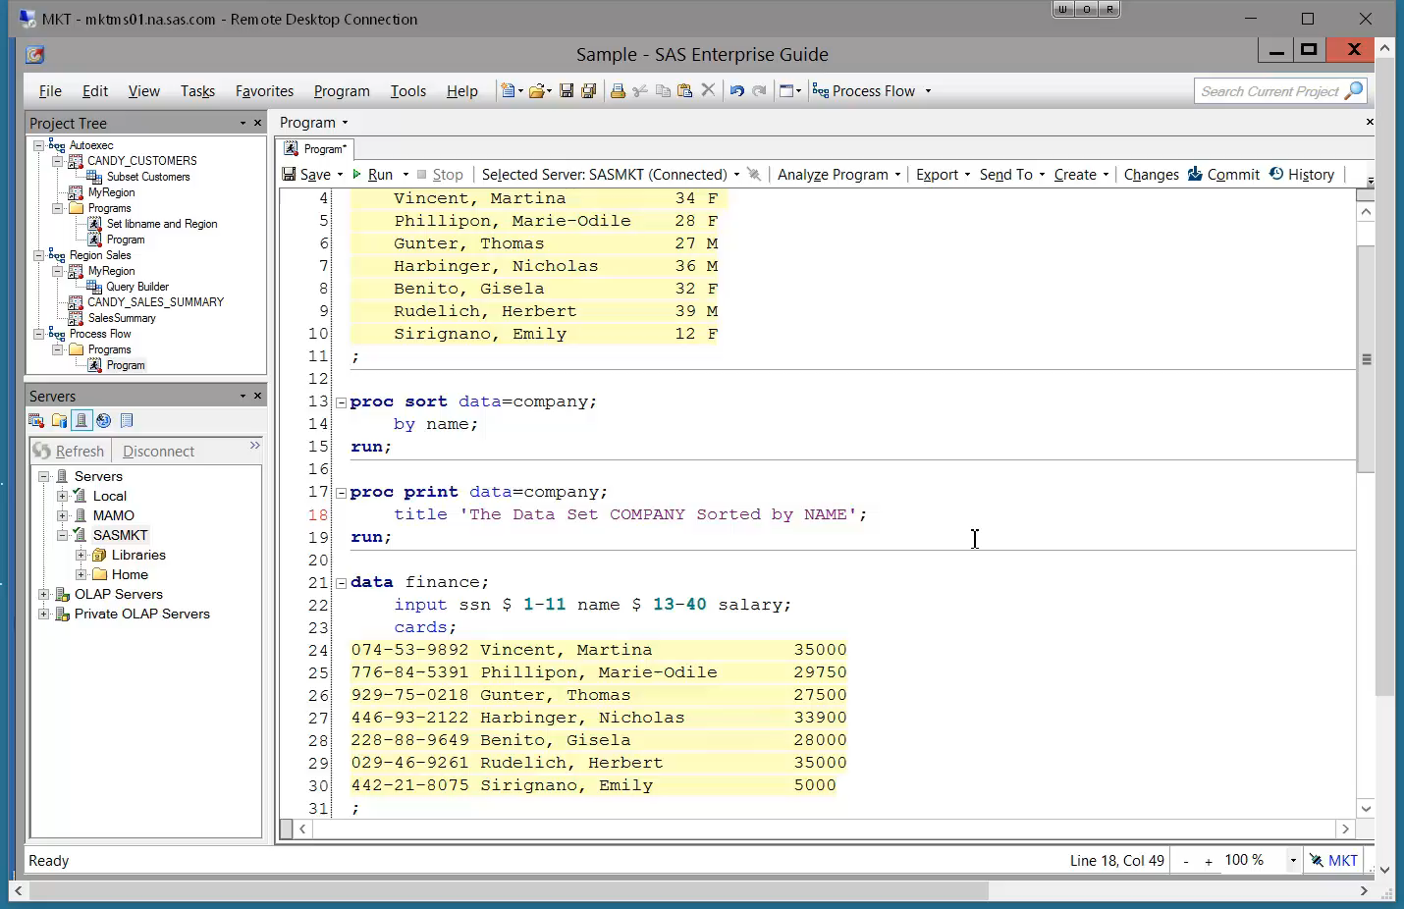
9. Copy a Column
Notes:
Time saver
Left mouse and ALT
Saved us from rewriting 7 lines of data

Slide 16
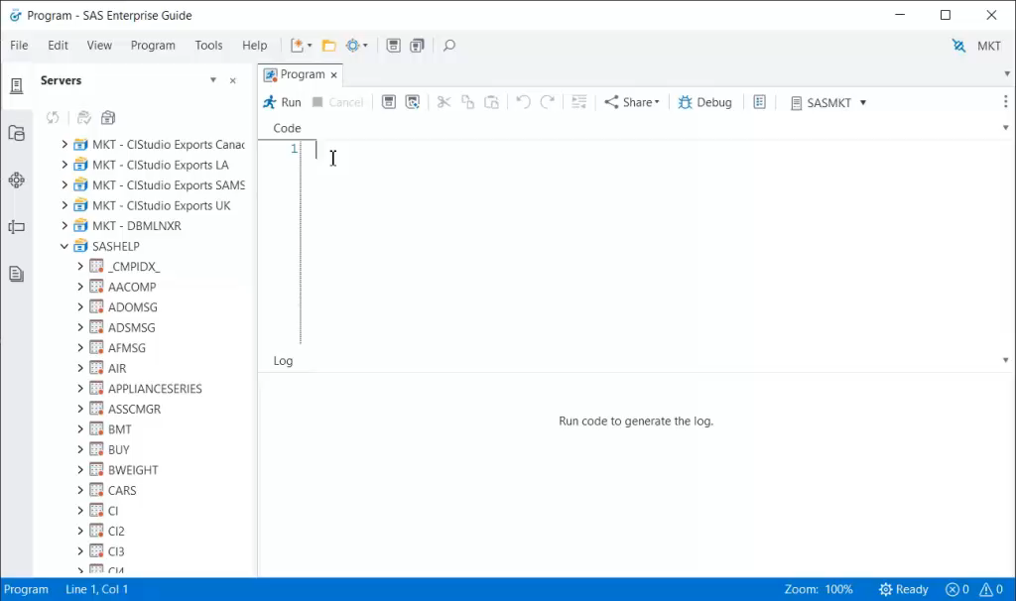
10: Drag & Drop Data Set Names and Variables
Notes:
New feature for EG 8
Drag dset name over into code
Cntrl key to select multiple vars and drag them over
Reduce spelling errors, timesaver

Slide 17
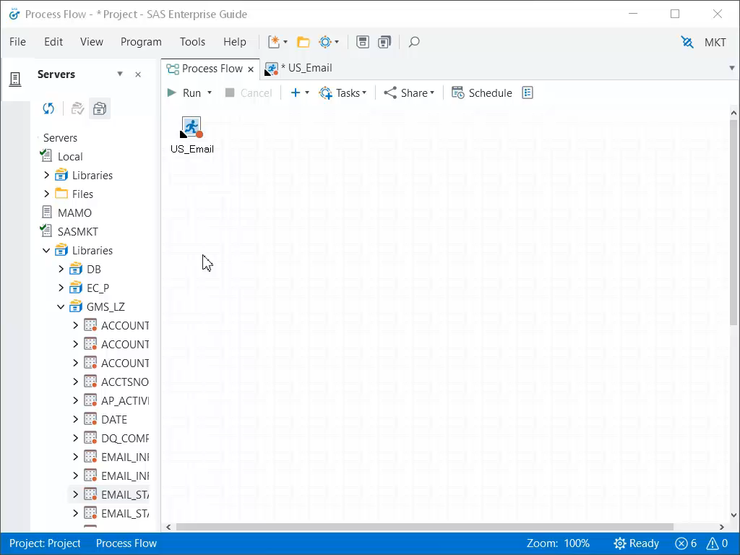
11. Select Server for Code Execution
Notes:
Run your program, get an error that library doesn’t exist
Check the server that your code is running against
Right click on code node, select server
Or use the pulldown in the program

Slide 18
Logs and Status!

Slide 19
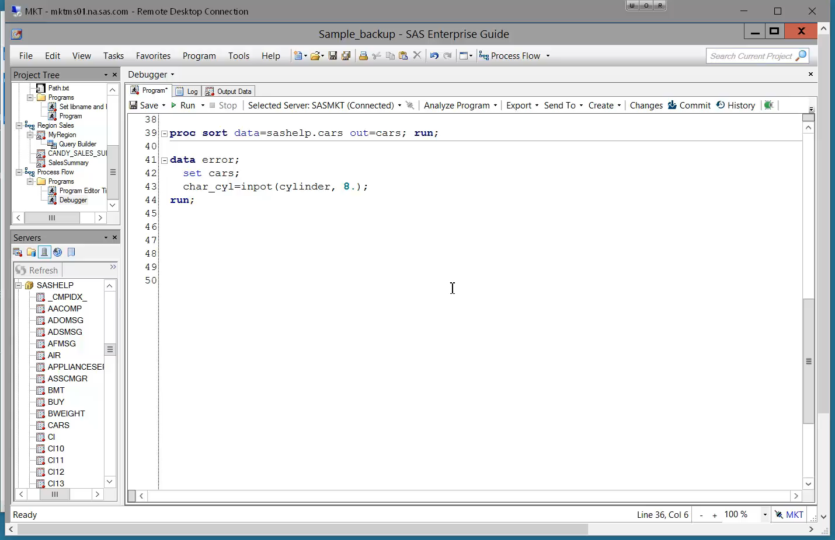
12. Enable Project Logging and Find Errors
Notes:
Way to track all the tasks and code run in the project and enable you to view the logs all in one place
Tools → options → General → Enable project log for new projects
EG 8 tools → Options → Project & Process Flows →
Run the code, see an error in the log
Look at log summary, expand the log for this run of the code
Remove warnings, notes
Click on error in log summary to jump to error

Slide 20
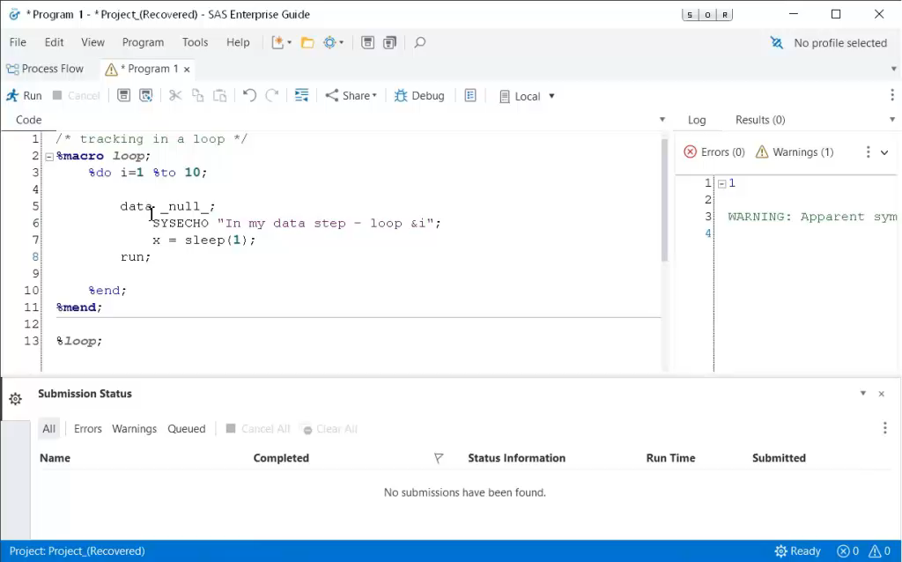
13. Status Updates for a Running Program
Notes:
SYSECHO displays a user defined status message
Message displays until another SYSECHO, DATA or PROC step is hit
EG 7 → Task Status window
EG 8 → Submission Status window
Look at log summary, expand the log for this run of the code
Remove warnings, notes
Click on error in log summary to jump to error

Slide 21
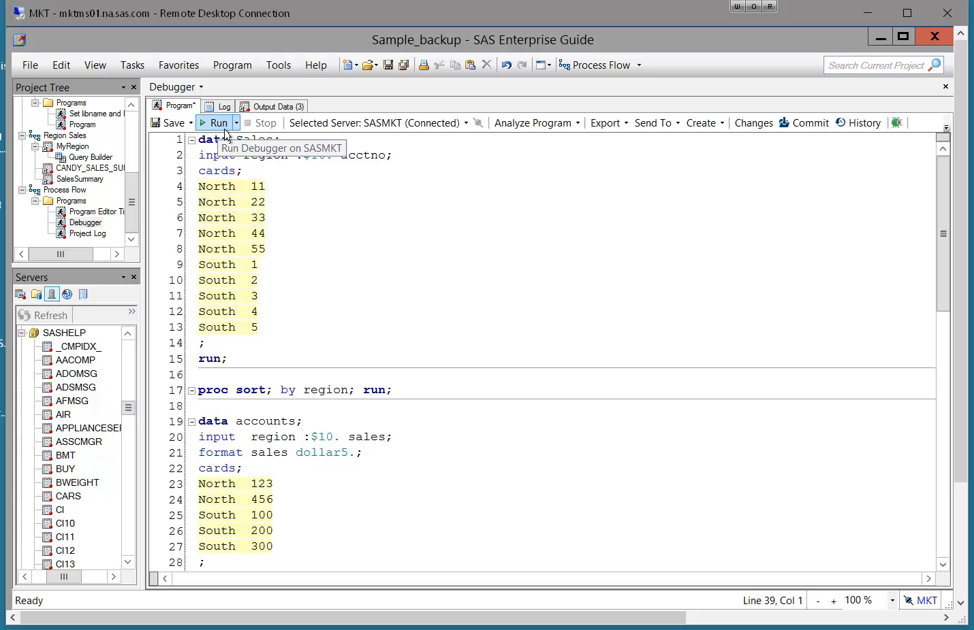
14. Declutter Log
Notes:
In EG, a lot of “noise” in the the log – wrapper code that contains macros and ods
Makes log hard to read
Tools → Options → Results General → “Show generated Wrapper code in log”
Log is cleaner
(same in EG 8)

Slide 22
Tasks and Queries!

Slide 23
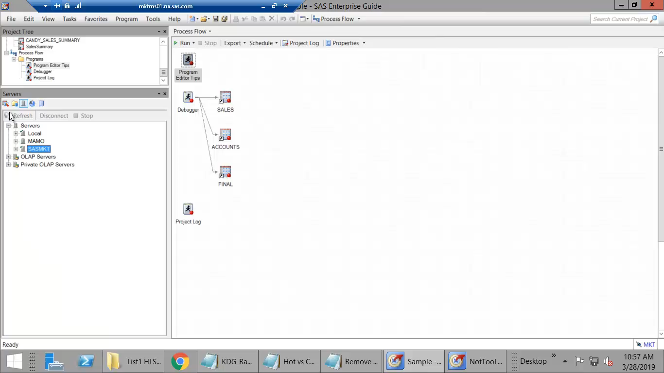
15. Find the Right Task
Notes:
EG Tasks run SAS Procedures behind the scenes – but what if you know the procedure you want to use but don’t know what task it maps to?
Task pane
Filter option, or search by name.
Hover over to get more info, select * to make it a favorite

Slide 24
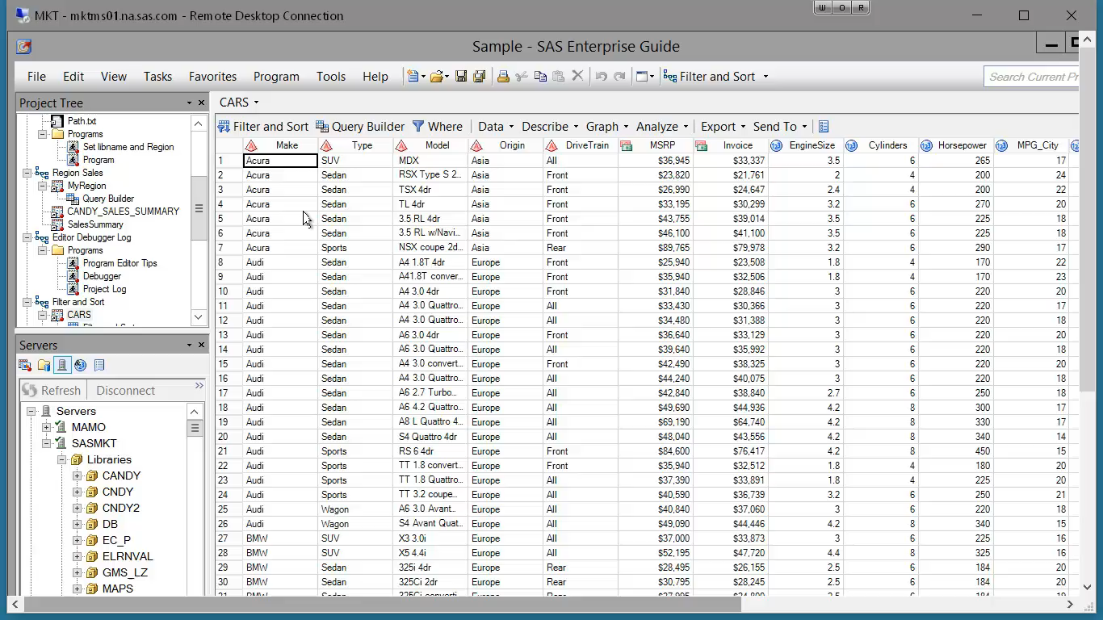
16. Filter and Sort
Notes:
2 tasks that let you sort – what’s the difference?
Filter & Sort: can not eliminate duplicates
Access from data grid
See in results -- > Duplicate types per model! -- 5 Sedans
Sort Data Task – Proc Sort, can control by-groups
Select “keep only first record for each ‘sort by’ group”
Elimates duplicate types

Slide 25
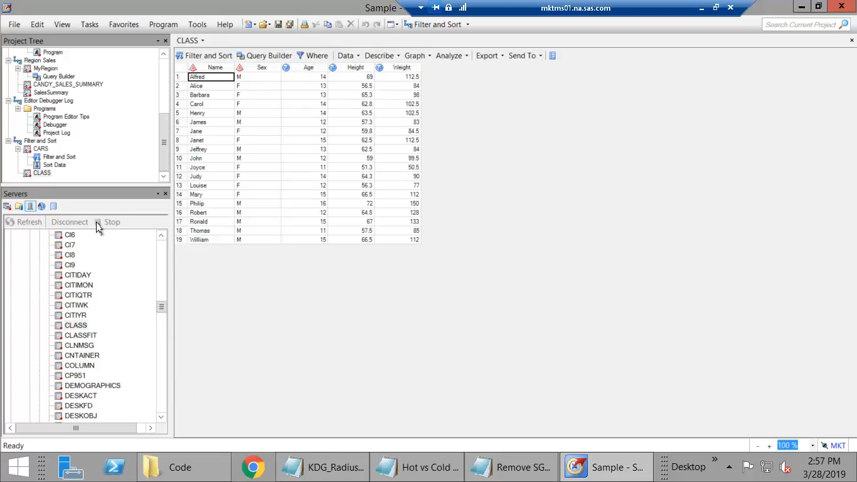
17. Create Dynamic Queries
Notes:
Create a macro variable that can be used in queries and code in the project
Create query that calculates avg height
Want to dynamically select gender of height to calc avg of
Use Prompt Manager to add new prompt
Name the prompt “gender”
Text prompt set to “Select a gender”
Select prompt type & values
Text
User selects from a static list – use the CLASS dataset to populate the list that they can choose from
Set a default (F)
Use the prompt in a query
Filter where sex= ……….select prompt from prompt tab
Run query
63.91 is avg height

Slide 26
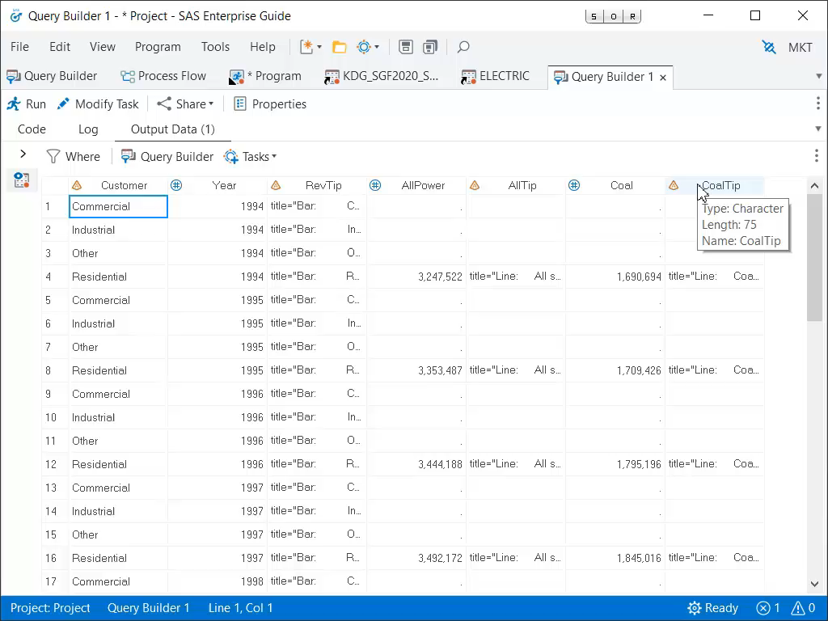
18. Resize Columns
Notes:
Data can be truncated in data grid
EG 8, columns are automatically sized by default
tools→ options→data→ general → auto size column widths
EG 7, double click the space between 2 columns to expand to widest value

Slide 27
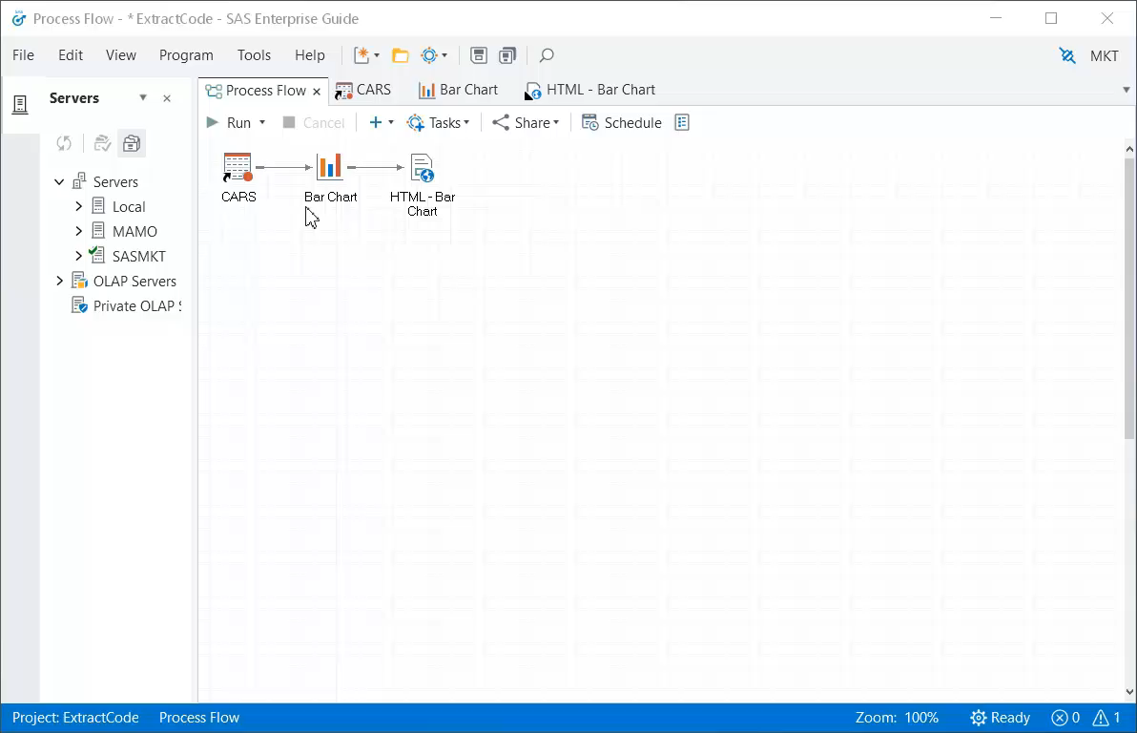
19. Extract Code From Tasks & Queries
Notes:
Tasks & Queries generate code
Ex: Bar chart wizard to create bar chart, don’t need to know proc gchart
EG 8: Reuse the code by right click on bar chart task, “Extract code”
EG 7: Open → open last submitted code, copy & paste into node

Slide 28
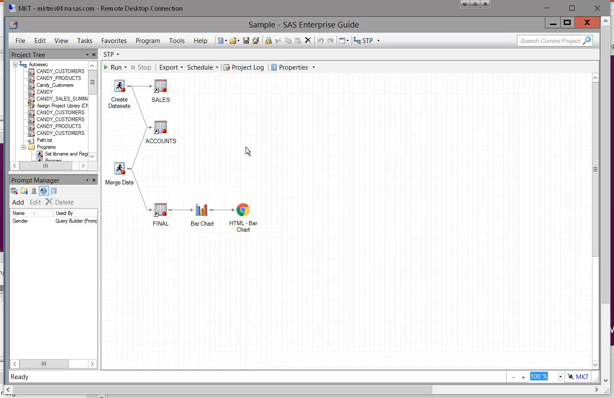
20. Create Stored Process
Notes:
Can easily create a stored process from project or process flow
STP puts all the code from the project into a bundle and stores it in a central location where it can be accessed by remote clients
Right click, select “Create stored process”
Give stp a name
Step through the wizard
Can view all the code from the project that will be included in the stp
Choose where to execute the stp
Run the stp

Slide 29
We made it!

Slide 30
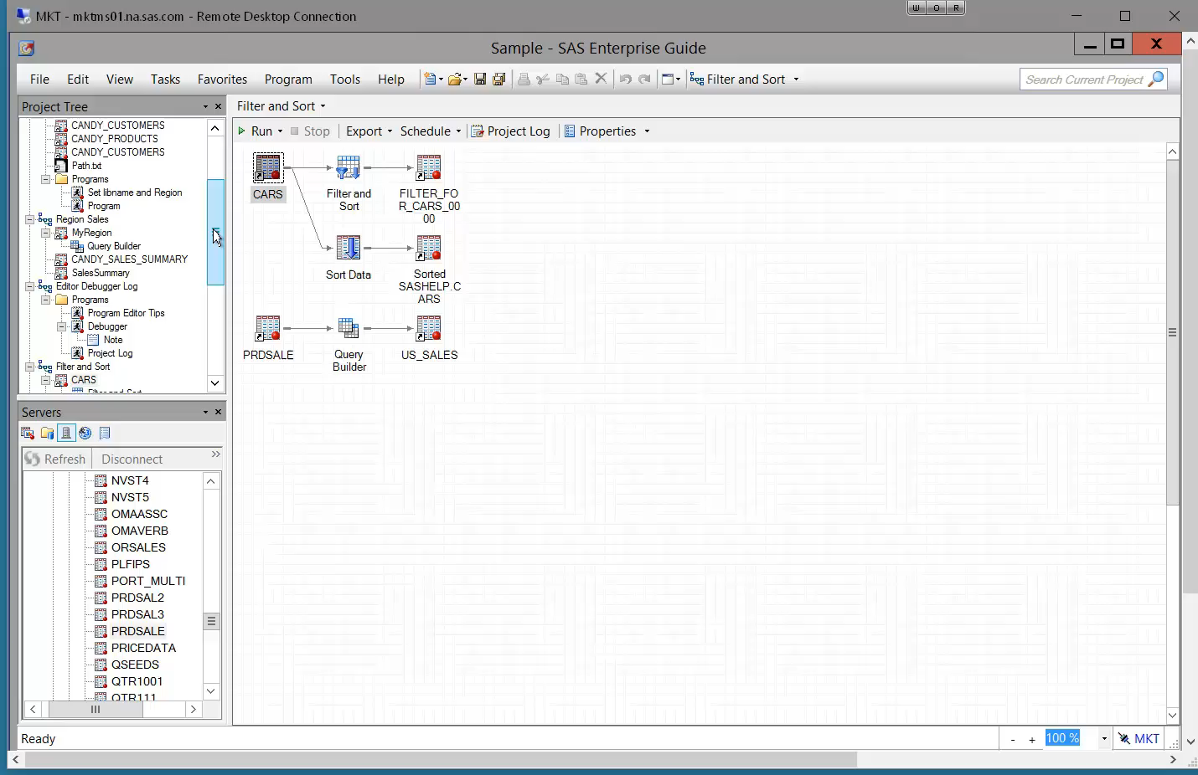
Bonus Tip: Search Project

Slide 31
Thank you!
Kelly Gray Kelly.Gray@sas.com
Reminder: Complete your session survey in the conference mobile app.

